Slide 1
Database Concepts

Slide 2
Course Overview
3 Day Course.
Introduction to Relational Database Concepts
Database Design and Data Modeling
Storing and Retrieving Data
Building Forms and Reports

Slide 3
Course Objectives
To provide an understanding of the basic concepts and terminology associated with Relational Database Theory.
To use Microsoft Access to create a simple relational database.
To build a database application using appropriate tables and relationships.
To become familiar with the types of structures you will be building with other technologies in later courses.

Slide 4
Agenda for Day 1
Introduction to MS-Access
  building a simple database
Designing a Database
  Introduction to Relational Database theory
  Terminology, Rules and Concepts
  Entities, Relationships, Attributes
  Cardinality
Day 1 Assignment

Slide 5
Agenda for Day 2
Discussion of Day 1 exercise
Designing a Database (continued)
  Normalization
  The ER diagram
Storing Data
  building a database from a model
Retrieving Data
Introduction to SQL
Day 2 Assignment

Slide 6
Agenda for Day 3
Discussion of Day 2 Exercise.
Building Forms
Building Reports
Day 3 Assignment
  hand-in by 11:30pm Monday (upload to D2L)

Slide 7

Course Evaluation
Database Assignment 100%

Slide 8
Day 1
Introduction to MS-Access and Relational Databases

Slide 9
What is a Database?
Collection of Related Information or Data
Organized in some manner
Electronic or Paper based
Examples:
  Phone Books
  Medical Records
  Mailing Lists
  Dictionary / Encyclopedia

Slide 10
Why Use a Database?
Sort Data
Extract Data
Summarize Data
Perform Complex Analyses
Improve Business Processes

Slide 11
Introduction to Microsoft Access

Slide 12
Access Intro
Safari Tech Books
  connect through http://library.sait.ca
  Microsoft Office Access 2010 Step by Step
  by Steve Lambert; M. Dow Lambert III; Joan Preppernau
  Download and unpack CD Content

Slide 13
Access Intro
Walkthrough
  Design view
  Datasheet view
  Records are recorded in rows
  Record selector symbol --current record
  Pencil --record you are working on
  Asterisk –record entry row
  Automatically saves any changes in current record when you move to next record

Slide 14
Table Design Basics
Include necessary data
Store data in its smallest components
Do not use calculated fields
Create table in Design view
Assign appropriate field names and data types
Assign the primary key
Table properties
Difference between Design and Datasheet views

Slide 15
Table Properties
Field size
Format
Input mask
Caption
Default value
Validation rule and validation text
Required
Allow zero length
Indexed

Slide 16
Day 1
Designing a Database

Slide 17
Introduction to
Relational Databases
Collection of two dimensional column and row tables which contain information to represent a situation.
Proposed by Dr. E. F. Codd in 1970.
Based on mathematical relation theory.

Slide 18
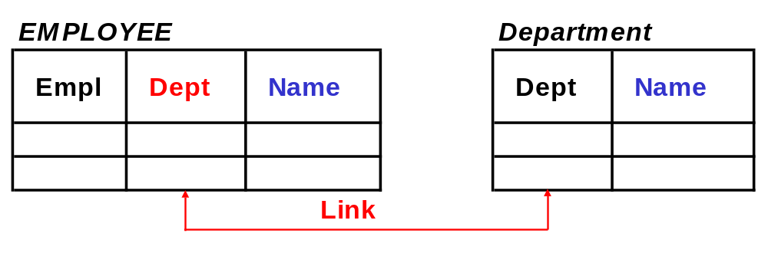
What is a Relational Database?
A collection of data & information organized into tables with columns & rows
  Each table is related to other tables.
  For example, Employee table is related to Department table.
    employees are assigned to departments.
  employee information is stored in one table; department information is stored in another table.
  department is stored as a column in employee table - links the employee to the department.

Slide 19
What is an RDBMS?
Relational DataBase Management System
A software tool - to manage the data and information in a database.
Allows you to:
  Add new data and information, update existing data and information.
  Alphabetize, categorize and perform calculations
  Retrieve and print information in a wide variety of ways.
  Find data and information.

Slide 20
How do we know what the database should contain?
Situation Description
  Written description of processes and data used in a workplace

Slide 21
Situation Description
Identifies what data must be stored, how it is used, who uses it, etc.
  End users talk and write about their work
  Analysts gather and write descriptions about each process to ensure understanding
  Need to ask questions, listen carefully, clarify, observe, participate
  Need to identify and confirm problems
  design of relational data model emerges and evolves from this process

Slide 22
Situation Description
Situation description has nouns, verbs and modifiers.
  Provide sufficient information to understand the given situation
  Nouns: Identify the things we need to keep information about
    Entities
  Verbs: Show how these things relate to, or interact with each other
    Relationships
  Modifiers: Are individual data items that describe each of the things in more detail
    Attributes

Slide 23
Grammatical Terms in a Situation Description
NOUNS are the names of persons, places or things
  customer, customer type, equipment, equipment type, purchase order
VERBS are actions or modes of being
  customer places an order, an employee works in a department, a department has employees in it
MODIFIERS may be adjectives or adverbs
  ADJECTIVES modify or refer to nouns
    size of an item, quantity on-hand of an item
  ADVERBS modify or refer to a verbs
    an item is ordered on a purchase order, quantity of the item ordered

Slide 24
Example of a Situation Description
A University currently employs instructors Gonzales, Anderson, Finnegan, Laurier and Mendez to teach each of their courses. Each instructor is identified by a unique number. Gonzales teaches in the Math department while Anderson and Finnegan teach in the English department. The others aren’t assigned to departments yet. Three other departments have been set up. Computer Science, Research and Publications but no instructors have been assigned yet. All departments have 2 character department codes.
Anderson is the lowest paid instructor with salary of $20,000 per year. Gonzales makes twice that. Finnegan also makes $40,000 whereas Mendez, the head instructor makes $10,000 more than that.

Slide 25
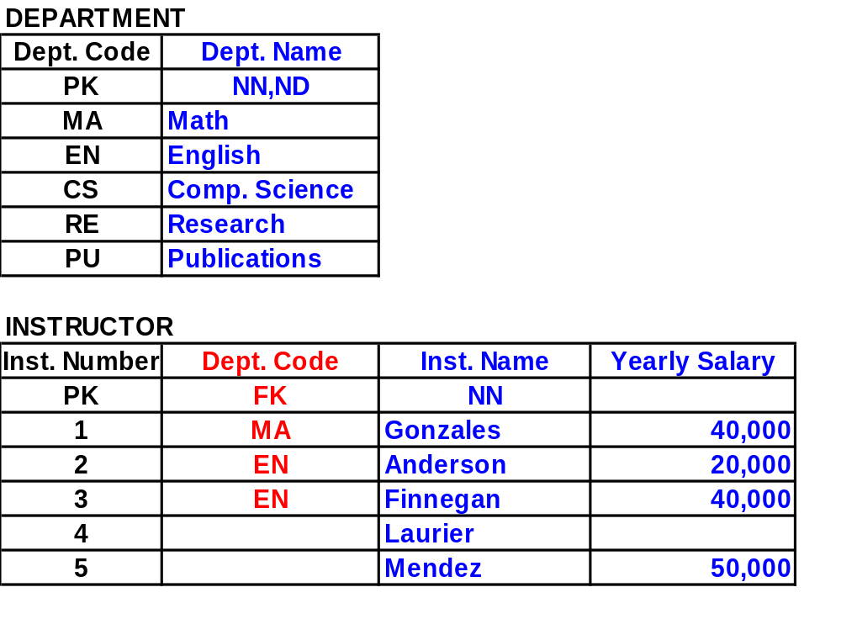
Model to represent the Situation Description

Slide 26
Discussion Exercise
In a group of 3 or 4, write a Short Situation Description that describes the process of booking a Family Vacation Package with a Travel Agency.
Examine the Situation Description to identify the Entities that would be required to represent the situation in a database.
Provide some sample Data that would be needed for each entity.

Slide 27
Database Terminology
Logical
  Entity
  Relationship
  Attribute
Physical
  Table
  Row
  Column
  Primary Key
  Foreign Key
  Indexes

Slide 28
Tables
Representation of data arranged in one or more vertical columns and zero or more horizontal rows.
  Row - information about one occurrence.
  Column - one specific characteristic of the items in the table
Table Rules
Rule 1. Table names must be unique.
Rule 2. Column names must be unique within a table.
Rule 3. Rows must be unique.
Rule 4. Columns must be non-decomposable.
Rule 5. Columns and Rows can be in any order.

Slide 29
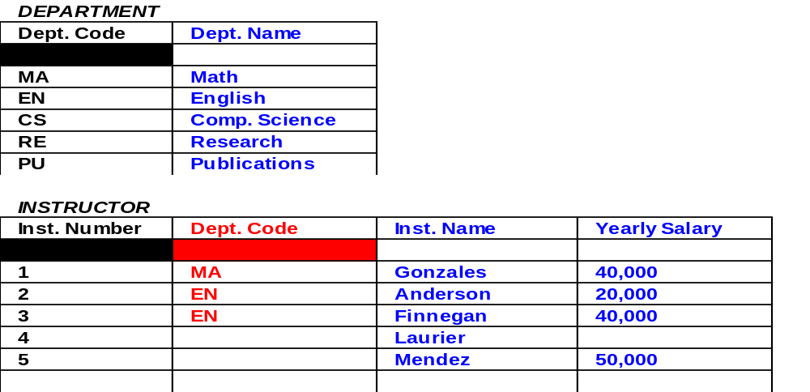
Table ROWS and COLUMNS
Each ROW in a table contains data and information about one occurrence of the content of the table.
Each COLUMN in a table contains one characteristic of the occurrences in the table.

Slide 30
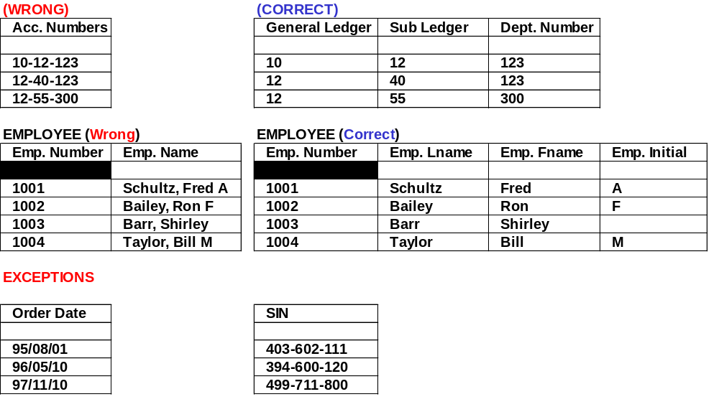
Example of RULE 4
COLUMNS must be non decomposable

Slide 31
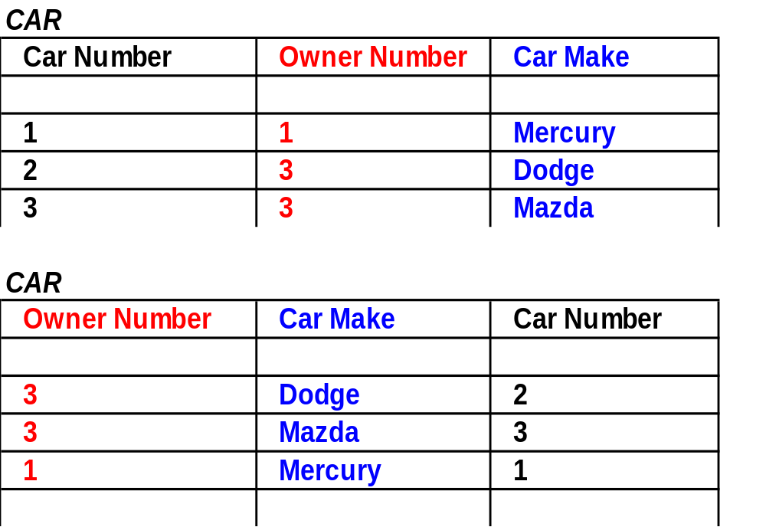
Example of RULE 5
COLUMNS and ROWS can be in any order

Slide 32
Primary Keys
Primary key of a table - the column or group of columns whose values uniquely identify each row or occurrence of data.
Every table must have a primary key
  Primary key of more than one column still classified as one primary key because you need the data in all of the columns to uniquely identify each row.
  Only one column or group of columns designated as the primary key.

Slide 33
Primary Keys
Primary Key values must never be null
Primary key values must never be duplicated
  Multi-column primary keys can have duplicates in each single column - never in all columns combined
Primary key values must never be changed

Slide 34
Primary Keys
Primary key columns - in any order in a table
  Columns in a table can be in any order - includes primary key columns
  Modeling convention to put primary key column(s) first on the table
    (Data more understandable)
Primary keys do not have to be sequential in rows
  Rows can be in any order - not necessarily in primary key sequence
  Convention to show rows in primary key sequence
    (Also makes the data more understandable)
Primary keys do not influence row access
  Rows can be accessed by any column

Slide 35
Relationship Types -- Cardinality
One-To-One (1:1)
  Entity A is related to zero or 1 of Entity B and
  Entity B is related to zero or 1 of Entity A.
  Example: Instructor (Entity A) and Desk (Entity B) -rare.
One-To-Many (1:M)
  Entity A is related to zero, one or more of Entity B but Entity B is related to zero or one of Entity A.
  Example, Department (Entity A) and Instructor (Entity B) - very common and occurs in every model.
Many-To-Many (M:M)
  Entity A is related to zero, one or more of Entity B and Entity B is related to zero, one or more of Entity A.
  Example, Purchase Order (Entity A) and Item (Entity B)
  - also common.

Slide 36
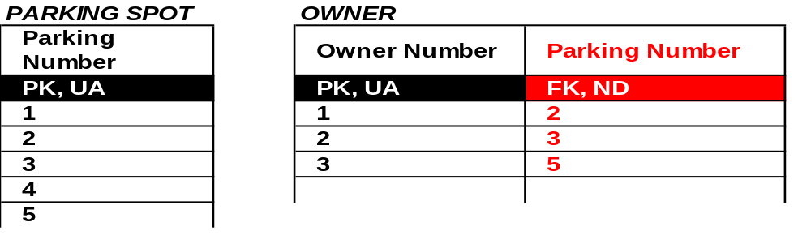
Example of 1:1 Relation
The convention is to put the PK of the larger table as a FK in the table with the fewer occurrences. This minimizes NULL values
The U label is necessary for the 1:1 relationship
It is possible for an owner to have no parking spot assigned; therefore, no NN label is required

Slide 37
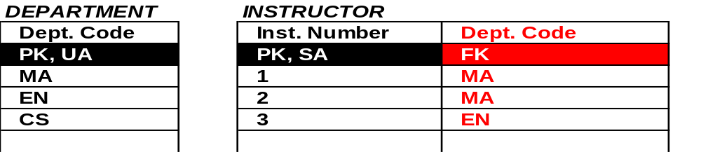
Example of 1:M Relation
The DEPT. CODE is modeled as FK on the Instructor table
The label FK provides a link between the two tables
If an instructor is always assigned a department then the FK column would be also labeled NN
The FK column cannot be labeled ND, because that would indicate a 1:1 relation
NOTE that the Instructor PK could not be placed as FK in the Department table because it would allow only only one instructor for each department
The DEPT. CODE may appear many times in the Instructor table

Slide 38
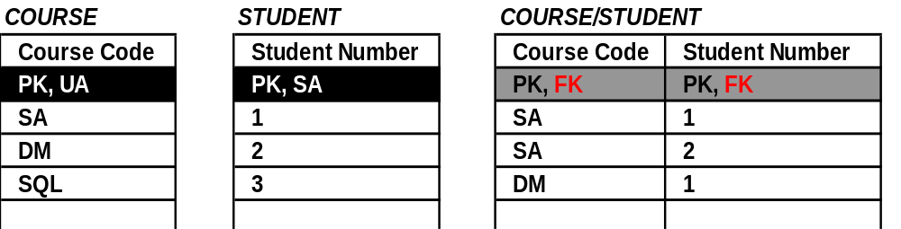
Example of M:M Relation
To model an M:M relation we draw another table
The new table has a multi-column PK consisting of 2 distinct FKs pointing to PK in the respective tables
The order of the 2 columns PK is arbitrary

Slide 39
Building Relationships in Access
Three relationships can be built in Access
  one-to-one
  one-to-many
  many-to-many
Use the Relationship window to add as many tables as required
Drag and drop to form relationships

Slide 40
Table Requirements
Many tables include both primary and foreign keys
One-to-One and One-to-Many relationships are created between tables by connecting the appropriate fields
Many-to-Many relationships require combining One-to-Many relationships and creating a new table
Use AutoNumber field for primary key when possible

Slide 41
Many-to-Many Relationships
Many-to-Many relationships built by a pair of One-to-Many relationships

Slide 42
Exercise 1
In your groups, find a small business application you are familiar with from your previous jobs and design a scenario that you can use to build a small database.
  Your database should have about 4 related tables, 2 forms, 2 reports, and 2 queries
  You don’t have to start building this yet. We will do that over the next couple of days.
Check out the Microsoft Access training materials at
  https://support.office.com/en-us/article/access-video-training-a5ffb1ef-4cc4-4d79-a862-e2dda6ef38e6

